Slide 1
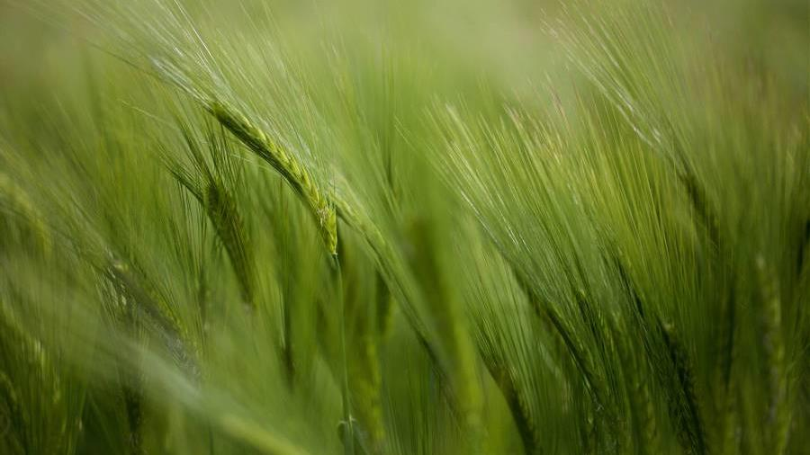
SECWEPEMCTIN INTRODUCTION & STSPTEKWLL
Karie Russell – March 1, 2023

Slide 2
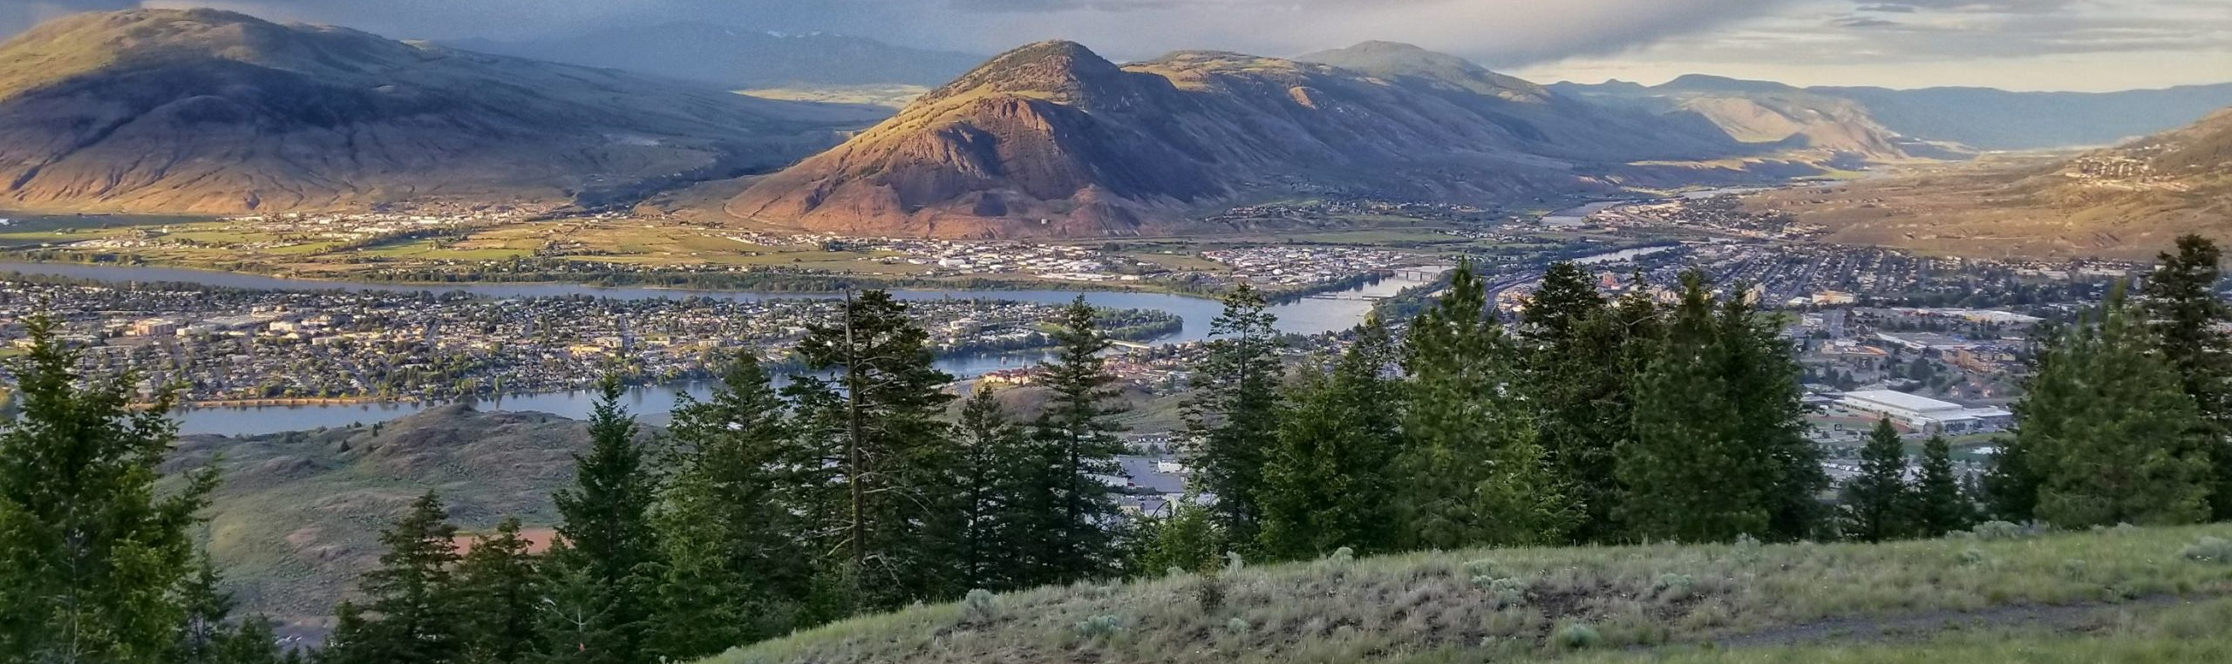
About ME
Tscwinúcw-kp
Weyt-kp xwexwéytep
Karie Russell ren skwekwst
Te Cobourg, Ontario re st̓7é7kwen within

Slide 3
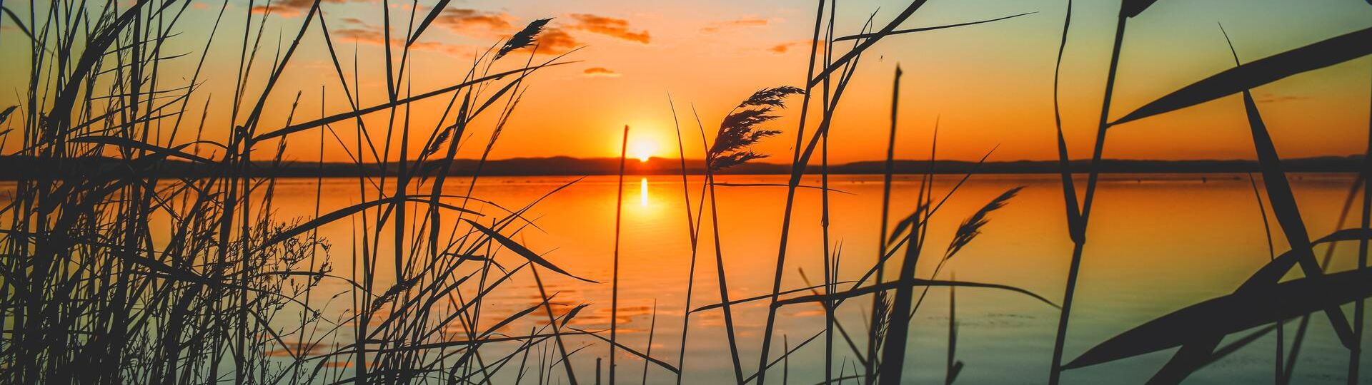
Alderville First Nation Mississauga Anishinabeg of the Ojibway Nation Located South-central Ontario Canada
Alderville First Nation
Located South-central Ontario Canada
Notes:
Sources:
Native Land Digital. Accessed February 28, 2023, from https://native-land.ca/.
Alderville First Nation. Alderville First Nation. Accessed February 28, 2023, from http://www.alderville.ca/

Slide 4
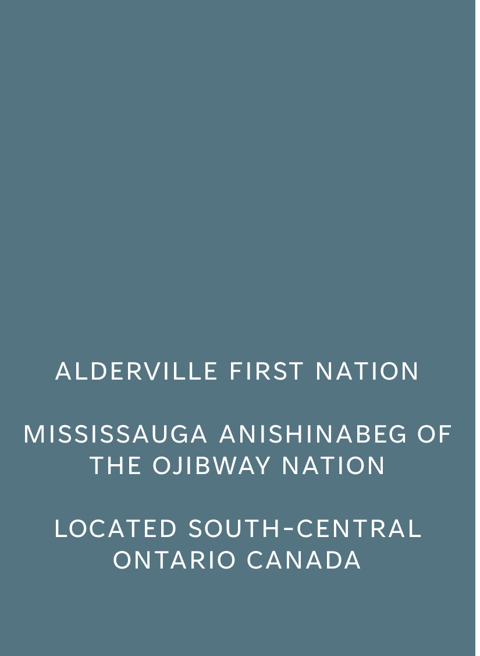
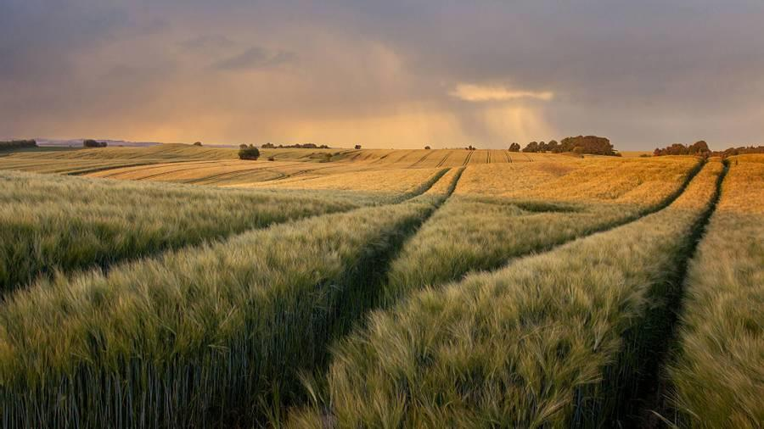
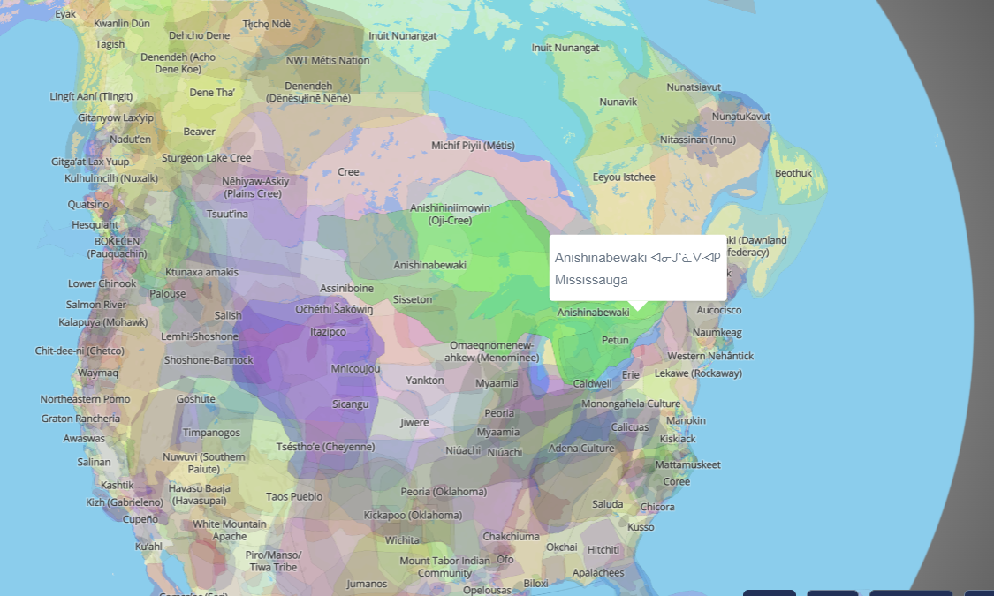
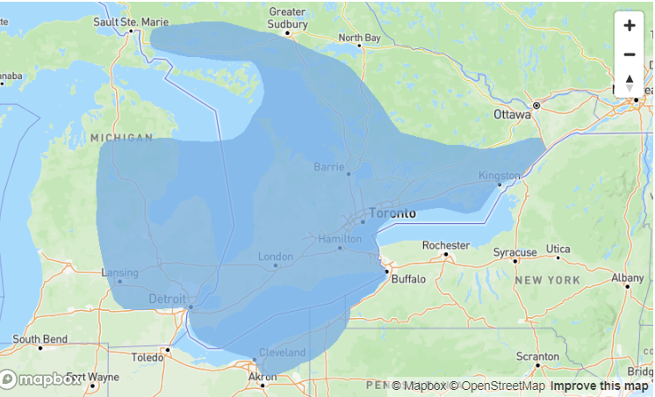
Company Overview
Source: Alderville First Nation https://alderville.ca/
Source: Native Land Digitlal https://native-land.ca/
Notes:
Source of images:
Native Land Digital. Accessed February 28, 2023, from https://native-land.ca/.
Alderville First Nation. Alderville First Nation. Accessed February 28, 2023, from http://www.alderville.ca/
Language Geek. "Anishinaabemowin." Languages of Ontario. Accessed February 28, 2023. https://www.languagegeek.com/maps/ont/languages_of_ontario.html.

Slide 5
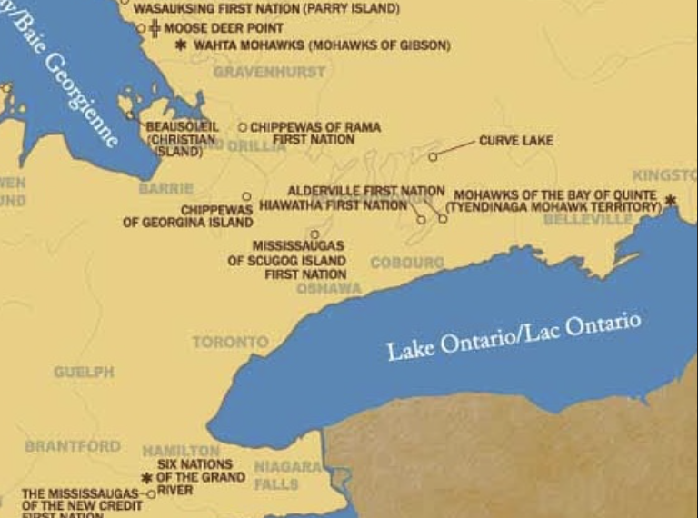
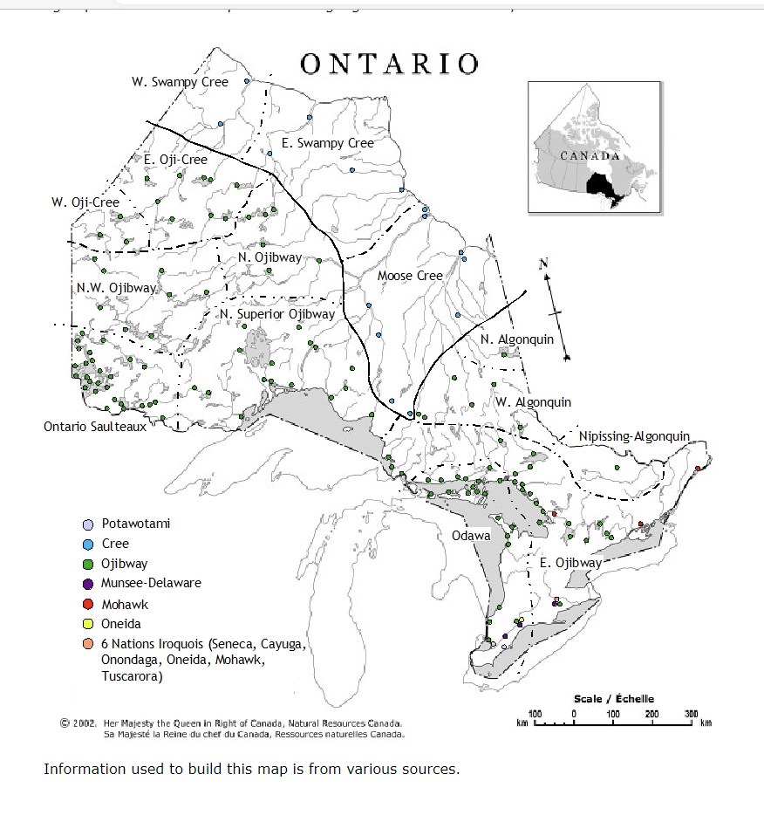
Source: Languages of Ontario (Language Geek)
Source: Alderville First Nation https://alderville.ca/
Notes:
Source:
Language Geek. "Anishinaabemowin." Languages of Ontario. Accessed February 28, 2023. https://www.languagegeek.com/maps/ont/languages_of_ontario.html.

Slide 6
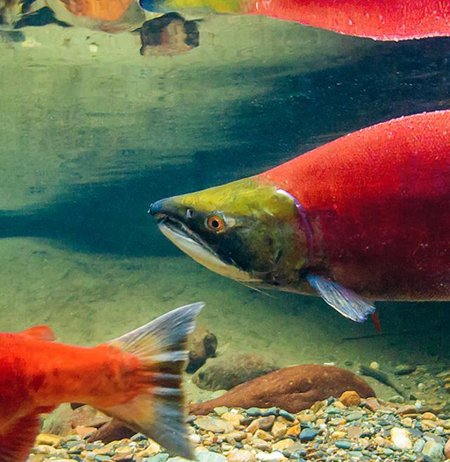
The STORY OF THE SALMON BOY
Notes:
This case is taken from a story entitled Story of the Salmon-Boy in James Teit, “The Shuswap” in Franz Boas, ed. The Jesup North Pacific Expedition: Memoir of the American Museum of Natural History Vol II, Part IV (Leiden: EJ Brill/ New York: GE Stechert, 1909) at 690.
Source:
Secwepemc Lands and Resources Law Research Project. Secwepemc Indigenous Laws: Secwepemc Lands and Resources Law. Victoria, BC: Indigenous Law Research Unit, University of Victoria Faculty of Law, 2018. 130.

Slide 7







A boy who lived with his grandparents went playing one day, and did not return. The people searched for him, and found the place where he had fallen into the river. His bow and arrows were lying on the bank.
The boy had been amusing himself by tobogganing on a piece of bark. He had slid over a bluff and landed on a piece of ice which was floating down the river. The boy floated down to the mouth of Fraser River, and arrived in the land of the salmon, where there was a great fish-dam.

Slide 8





After staying there some time, the boy told the Salmon chief that he wanted to return home. The Salmon Chief said, “Yes. When the Salmon go to your country, they shall take you with them.” Soon the Sockeye Salmon started to run up river, and the boy wished to accompany them; but the chief said, ‘No, you must not go with them. You would be hurt. They travel through many dangerous places.”
At last the King Salmon started to run up river, and the Salmon Chief let the boy go with them, in the charge of the king salmon. The boy swam with the king salmon after being transformed into a king salmon.

Slide 9

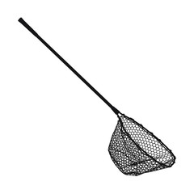
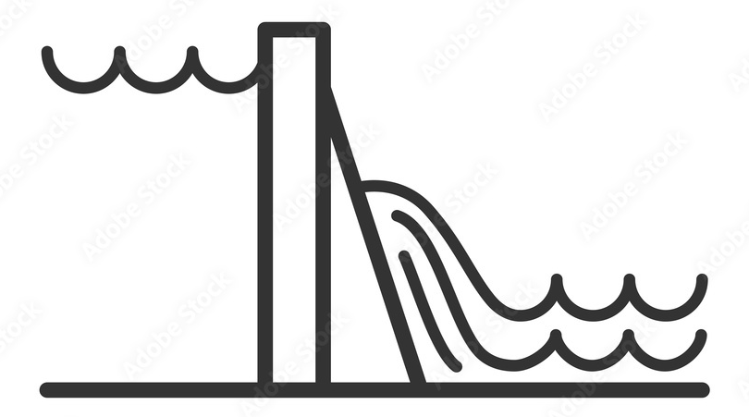




Now, the boy’s grandfather cried all the time because he believed his grandson to be dead. When the salmon began to run, the grandfather made a weir across the small stream near where he lived and there he fished by bag netting.
The boy came swimming up, and was caught by his grandfather, who was about to split and dry him, like other fish, when he noticed that the salmon’s eyes were like those of a human being. Then the grandfather rolled the king salmon boy up in a blanket, and hung him in a tree.

Slide 10




On the following day the grandfather unwrapped him and found that the whole head had become human. On the following day the king salmon boy had assumed human form down to the waist. On the third day he was man down to the knees; and on the fourth day, when the blanket was opened, the boy jumped out, saying, “It is I, grandfather! Tell no one of my return. Catch and cure all the fish you can, while I go and hunt.
In two months’ time I shall return, and we shall give a feast to the people.” Then the old man was so happy. Instead of weeping and singing dirges, he now whistled all day long. The people said, ‘Something must have happened to make the old man so happy. He has changed from sadness to happiness very quickly.”

Slide 11








In two months’ time the fishing-season was over, and the old man had cured many salmon and their roe, and had made much oil. Then the boy returned from hunting, carrying one of his mittens full of the meat, fat, and skins of deer; while the other contained meat, fat, and skins of marmots. He emptied out the contents of his mittens, and they assumed the form of a large pile of meat, fat, and skins.
Then he and his grandfather invited all the people who were surprised to see the boy, and feasted them many days.

Slide 12
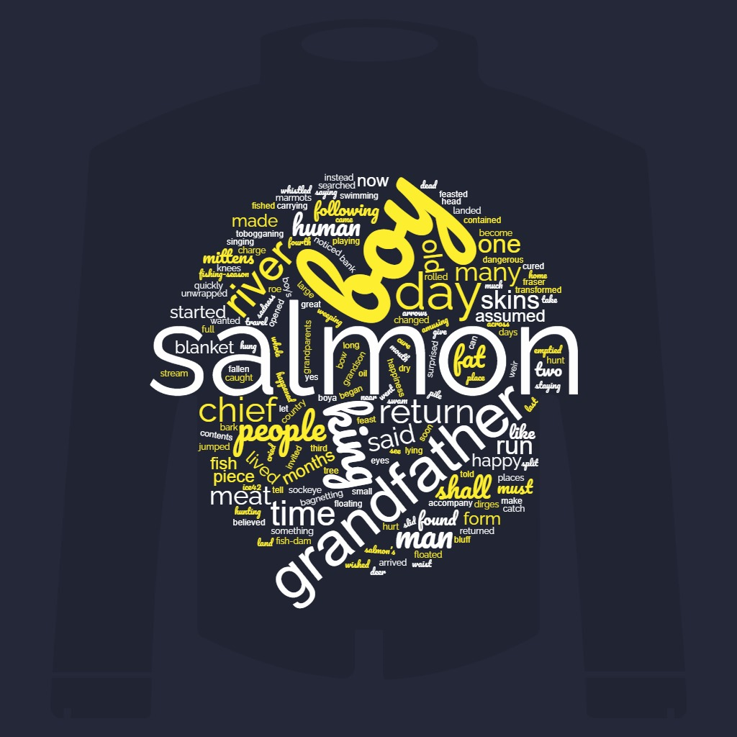
Notes:
Source: wordcloud

Slide 13
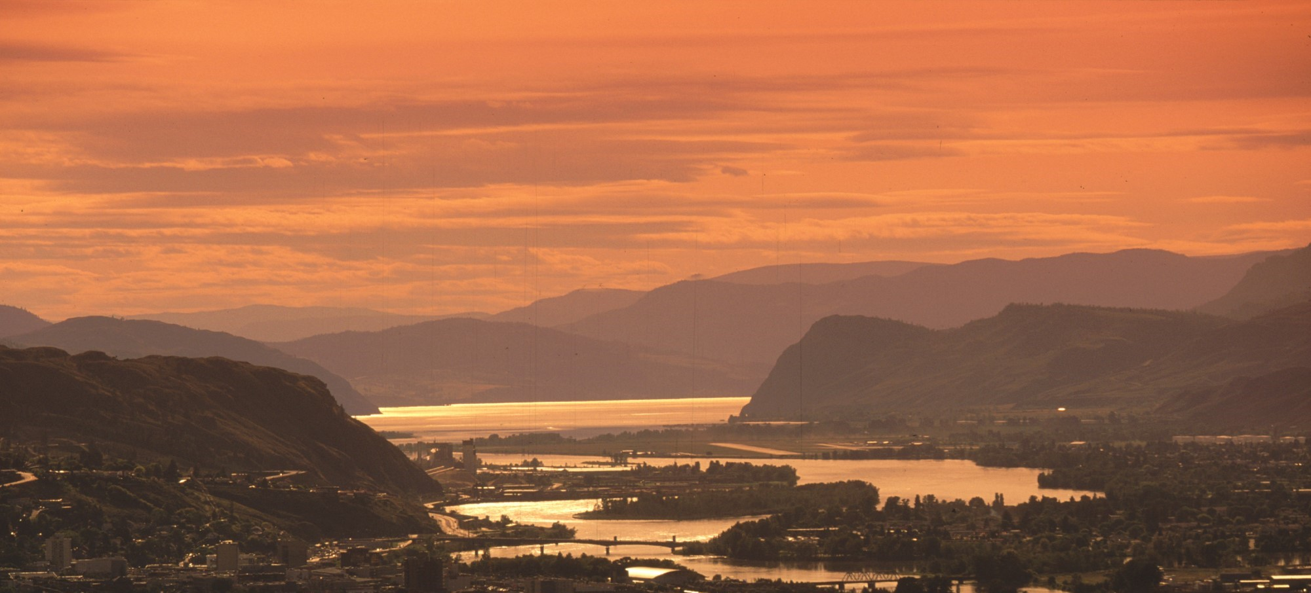
discussion
Underlying Principles?
What do you think?
What is unsaid?
What is said?
Notes:
Story of the Salmon-Boy
What are the responsibilities to a visitor on your land?
What is the main human problem the story focuses on?
3. How do we respond to one of our people who leaves and who returns from another land?
4. How do we respond to changes in one of our people (family, relative, kin, member of community)?
5. How does one learn the skills they need from the land? What facts matter? ·

Slide 14
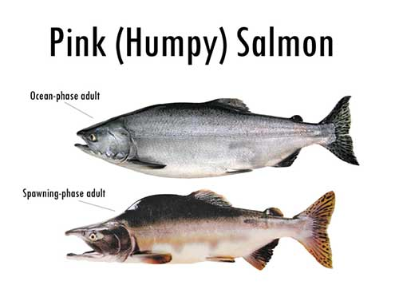
Kukwstsétsemc
Karie Russell
The Story of Salmon Boy
Notes:
Image source:
"The Great State of Alaska." Alaska Department of Fish and Game. Accessed February 28, 2023. https://www.adfg.alaska.gov/index.cfm?adfg=wildlifenews.view_article&articles_id=714.
“Window on the Fraser Eng.” Government of Canada. Accessed February 28, 2023. https://fisheriesandoceanscanada.app.box.com/s/lars8i6grp4ap3tmnqrguzftzft7ifeg/file/947889263077.

